Slide 1
Information Retrieval (IN4325)
Introduction to Natural Language Processing
Dr. Nava Tintarev
Assistant Professor, TU Delft

Slide 2
core information retrieval
natural language processing

Slide 3
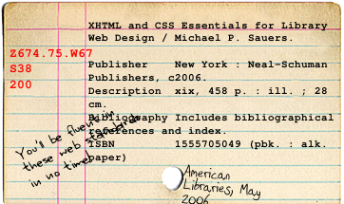
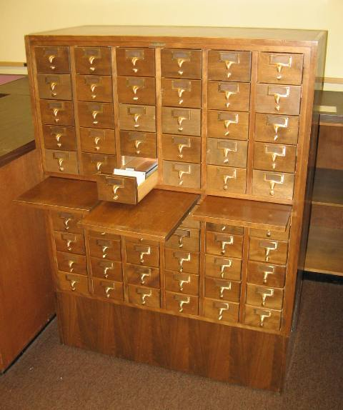
IR ...
deals with the representation, storage, organization of, and access to largely unstructured information items
is centered around information needs and the concept of relevance
has its roots in library and information sciences

Slide 4
Natural Language Processing
Focused on text.
Language - signs, meanings, and a code connecting signs with their meanings.
Natural – human communication, unlike e.g., programming languages.
Processing – computational methods to allow computers to `understand’…
In order to perform certain information need tasks.

Slide 5
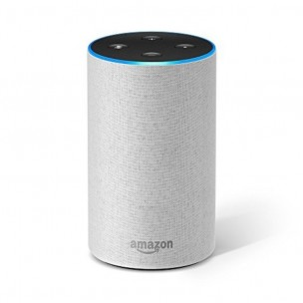
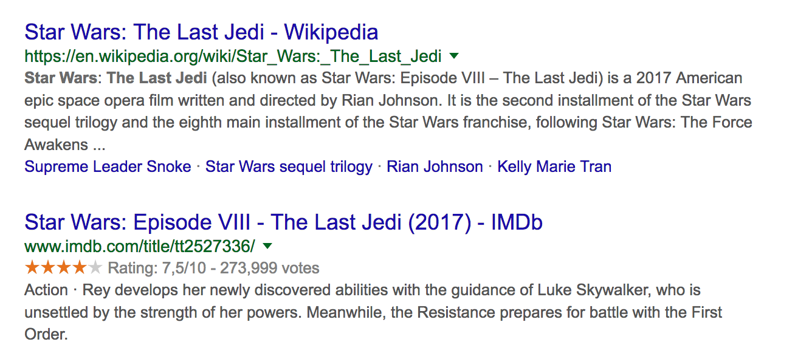
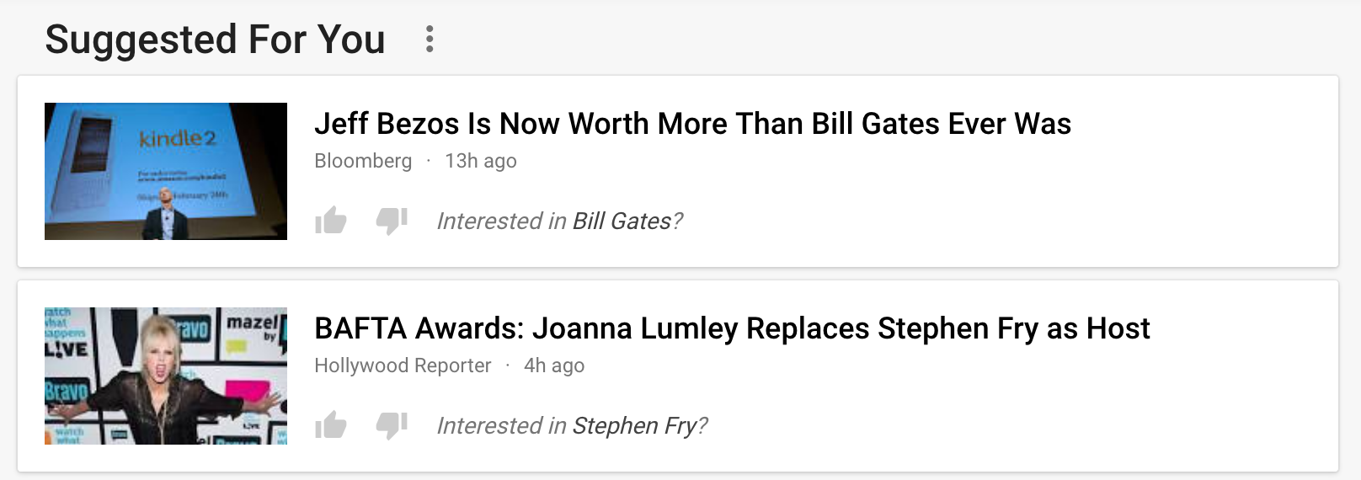
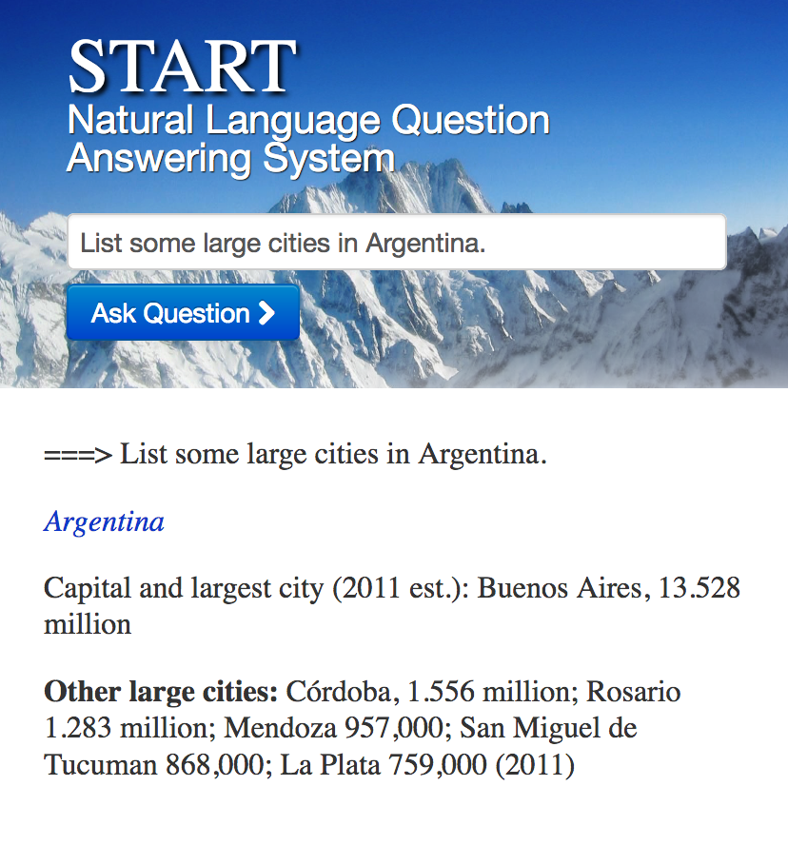

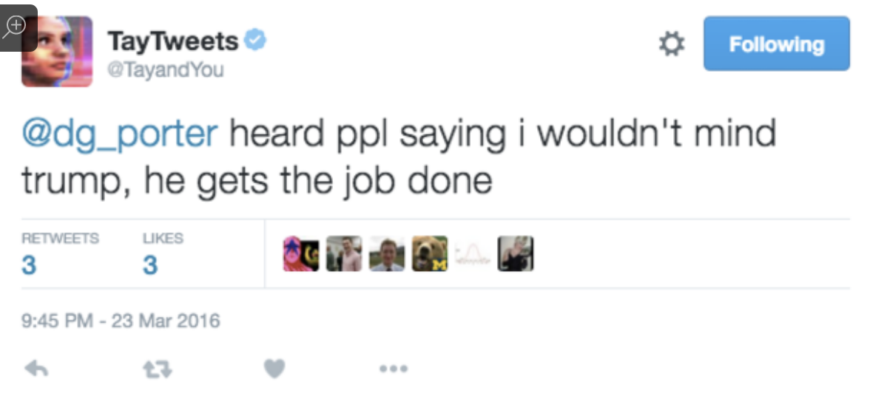
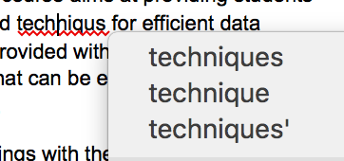


Applications
Notes:
START (SynTactic Analysis using Reversible Transformations)

Slide 6
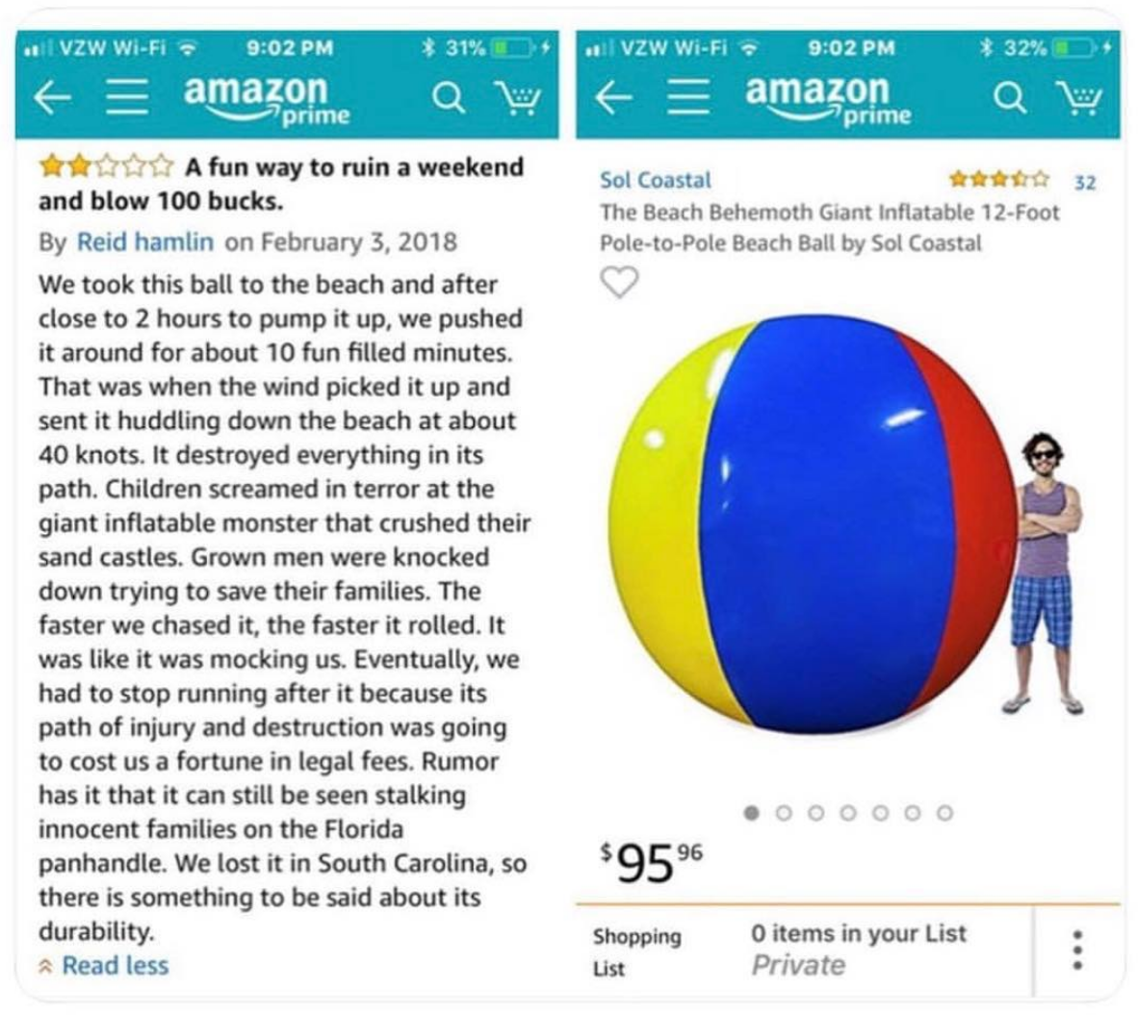
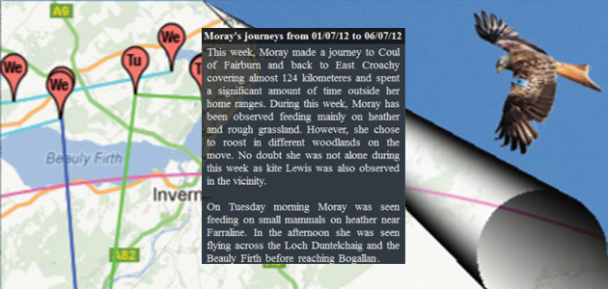
Natural language processing
From user to system
From system to user

Slide 7
Part 1:
Administrative Issues
Natural Language Processing Tasks
Part 2:
Terminology: Components

Slide 8
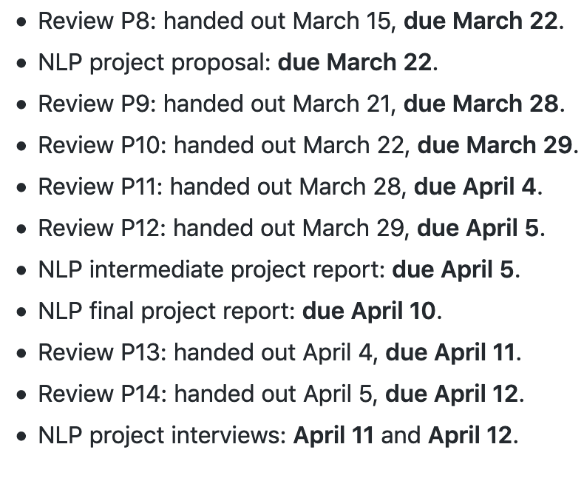
Paper reviews
7 for NLP as well, already online
Same template
Thursday ->Thursday and Friday-> Friday
No reading today!

Slide 9
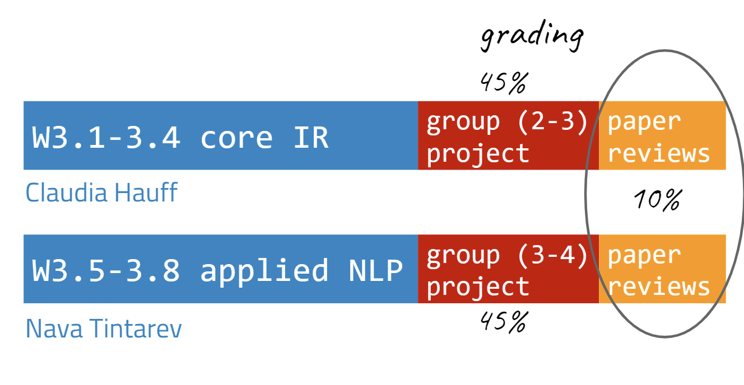
Grading
In order to pass this course, you need to fullfil all of the following:
Receive an overall grade of 5.8 or higher (in alignment with TU Delft's exam regulations).
Complete both project phases with at least a grade of 5.0.
Receive a sufficient for at least 9 of the 14 reviews.

Slide 10
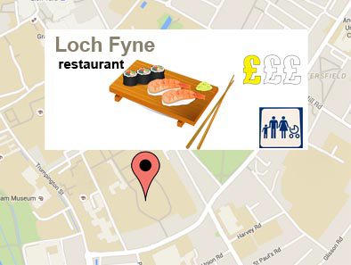
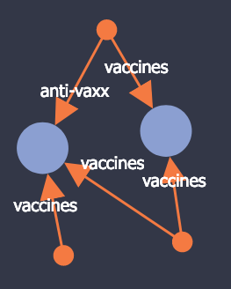
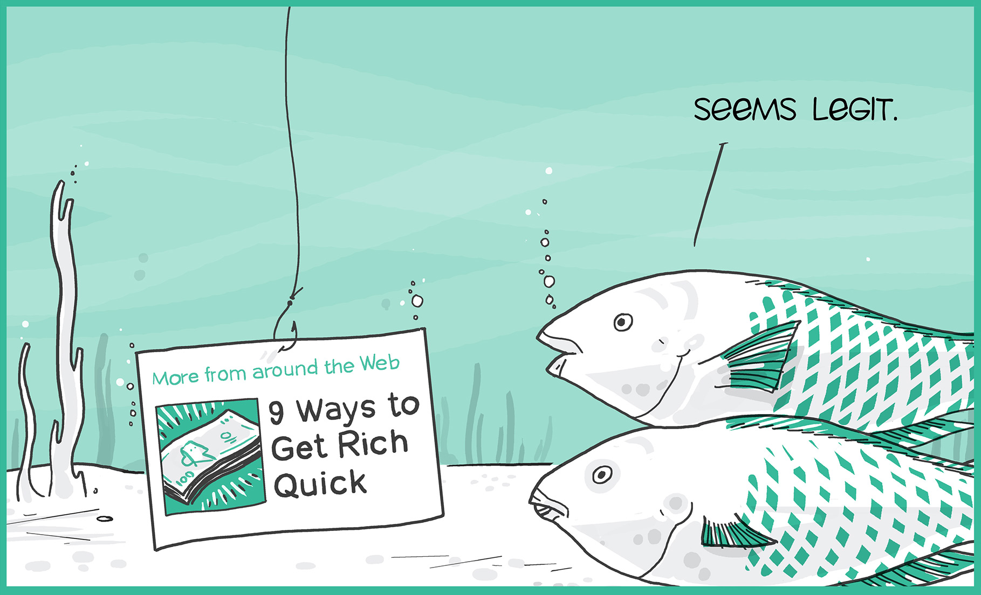

Group project
#find_a_team_member
What: Design, develop, and evaluate a system (NLP)
Group size: ~3 (NLP) ← Larger groups! More expected!
Due: Week 3.9 includes a group interview
Intermediate deadlines to get feedback: proposal & intermediate draft
Project options:
Reproducibility (SemEval etc.)
Original research
Example topics: image descriptions, Fake news, stance detection, sentiment analysis, click-bait detection,

Slide 11
Group project guidelines
Neural NLP ONLY if you have successfully completed the Deep Learning course beforehand.
If you build a classifier, the features you study should be motivated by linguistic theory.
If you use off the shelf solutions: be aware of the defaults and motivate why they are suitable for your problem.
What kind of biases might come from the dataset?
The project focuses on textual data.
Full details: https://github.com/chauff/IN4325/blob/master/projectAppliedNLP.md

Slide 12
Optional support hours: project
Fridays 9am-11:30pm (W3.6 - 3.8)
Sign up for one 15 minute slot!
Team: Oana Inel (postdoc), Shabnam Najafian (PhD), Nirmal Roy (TA)
Online here: https://queue.ewi.tudelft.nl/
flickr@jarbo
Notes:
Image: https://www.flickr.com/photos/jarbo/9379813470

Slide 13
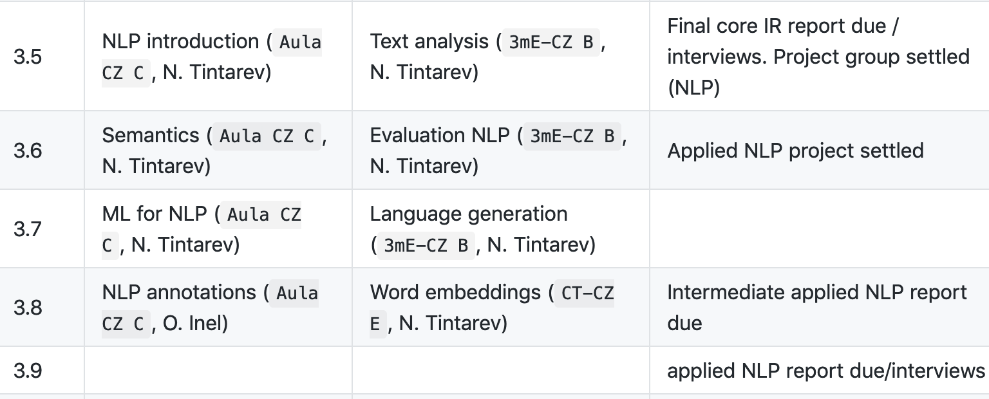
What will I learn?

Slide 14
Part 1:
Administrative Issues
Natural Language Processing Tasks
Part 2:
Terminology: Components

Slide 15
After today you should be able to…
Explain the function of Natural Language Processing
Identify NLP applications
Identify typical natural processing tasks
Recognize typical components/sub-tasks

Slide 16
Natural language processing tasks
Easy: spell checking, keyword search, finding synonyms
Medium: information extraction, summarization, stance detection
Hard: sentiment analysis, machine translation, co-reference, question answering
Notes:
(Jeopardy!)

Slide 17
Question Answering: IBM’s Watson
Won Jeopardy on February 16, 2011!
William Wilkinson’s
“An account of the principalities of Wallachia and Moldovia”
inspired this author’s
most famous novel
Bram Stoker
Notes:
From Jurasky and Manning

Slide 18
Information Extraction
Event: Curriculum mtg
Date: Jan-16-2019
Start: 10:00am
End: 11:30am
Where: 4.900
Subject: curriculum meeting
Date: January 15, 2019
To: Claudia Hauff
Hi Claudia, we’ve now scheduled the curriculum meeting.
It will be in 4.900 tomorrow from 10:00-11:30.
-Nava
Create new Calendar entry

Slide 19


Sentiment Analysis
Attributes:
zoom
affordability
size and weight
flash
ease of use
Size and weight
✓
nice and compact to carry!
since the camera is small and light, I won't need to carry around those heavy, bulky professional cameras either!
the camera feels flimsy, is plastic and very light in weight you have to be very delicate in the handling of this camera
✓
✗

Slide 20
Automated Summarization
Single document vs multiple document
Generic summarization versus query/focused/topic-based summarization
Extract versus abstract
http://newsblaster.cs.columbia.edu/

Slide 21
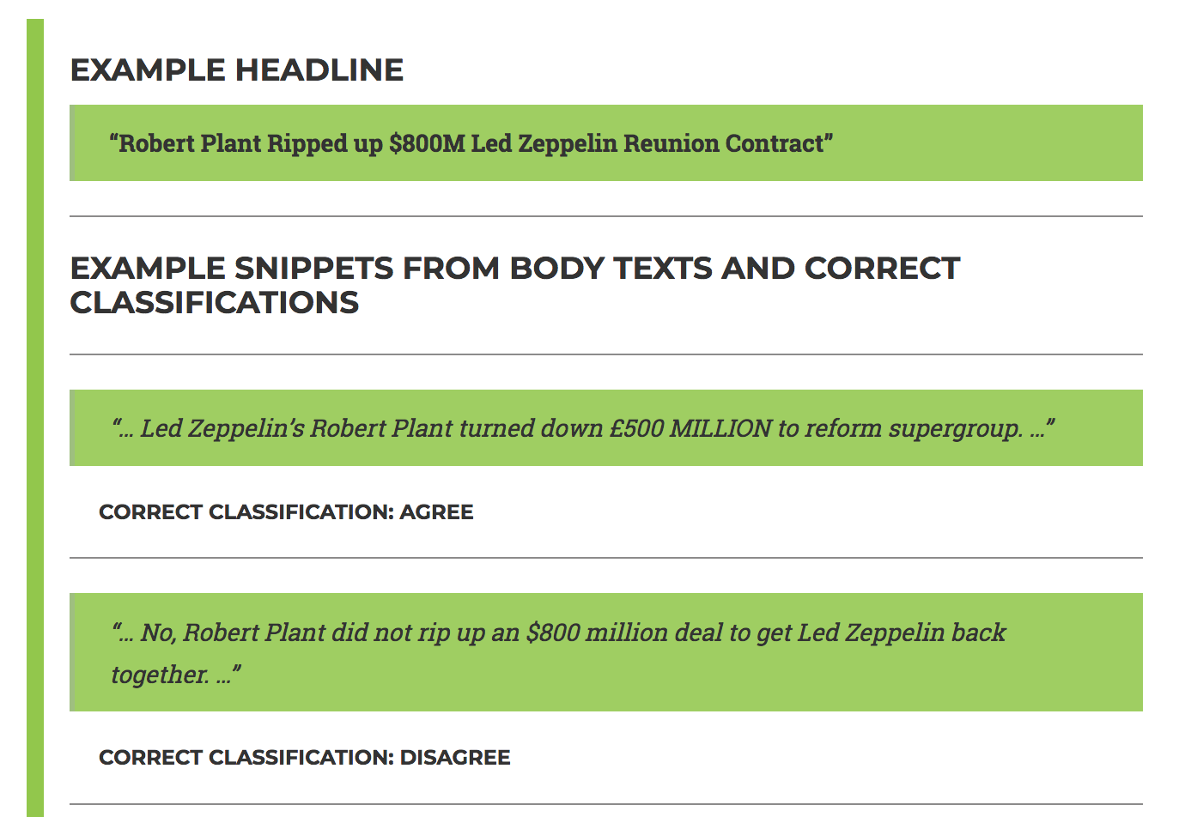
Stance detection
Input: Headline + text
Output: Classify stance (e.g., agrees, disagrees, discusses, unrelated)

Slide 22
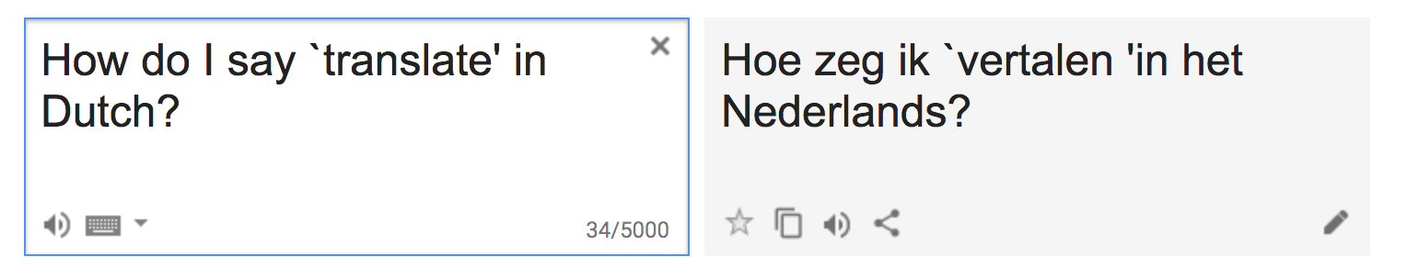
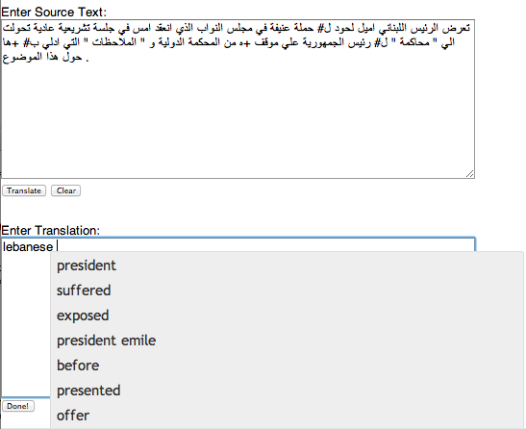
Machine Translation
Fully automatic
Helping human translators
"The flesh was weak, but the spirit was willing" → "The meat was off, but the vodka was fine".

Slide 23


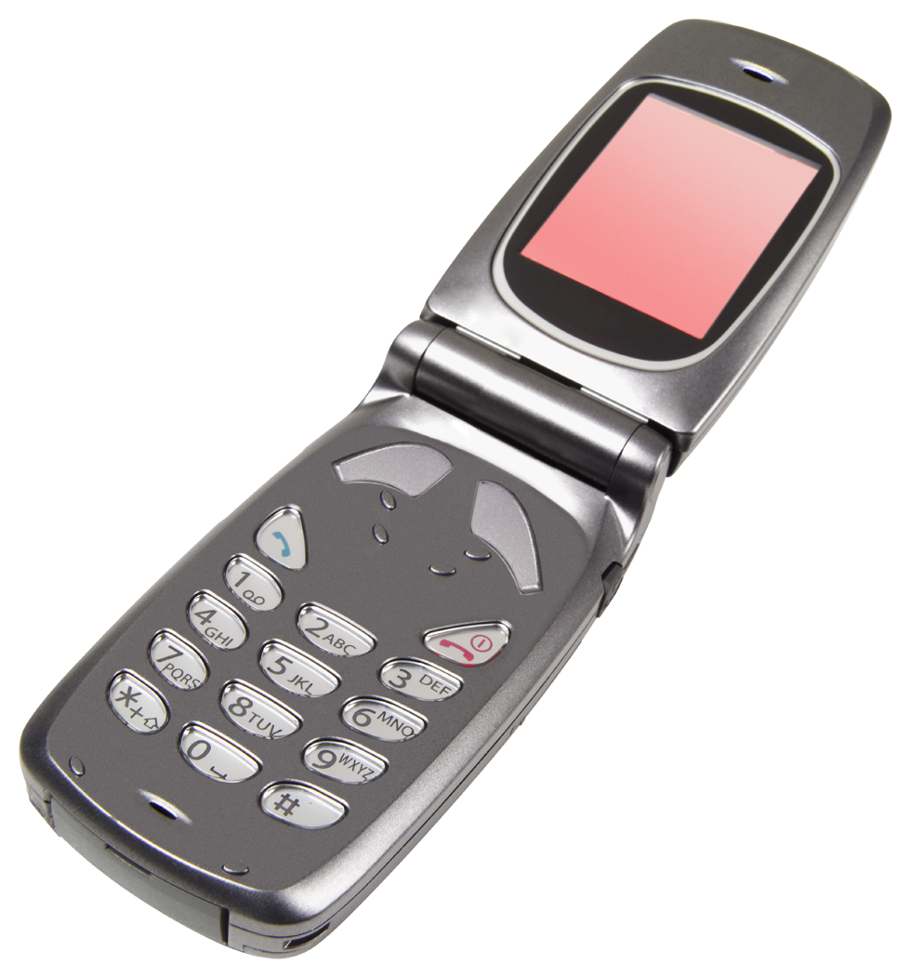

Tasks in NLP
making good progress
Sentiment analysis
still really hard
mostly solved
Best roast chicken in San Francisco!
Question answering (QA)
The waiter ignored us for 20 minutes.
Spam detection
Coreference resolution
Q. How effective is ibuprofen in reducing fever in patients with acute febrile illness?
✓
Let’s go to Agra!
Paraphrase
✗
Carter told Mubarak he shouldn’t run again.
Buy V1AGRA …
Word sense disambiguation (WSD)
XYZ acquired ABC yesterday
Part-of-speech (POS) tagging
I need new batteries for my mouse.
ABC has been taken over by XYZ
ADJ ADJ NOUN VERB ADV
Summarization
Colorless green ideas sleep furiously.
Parsing
The Dow Jones is up
Economy is good
I can see Alcatraz from the window!
The S&P500 jumped
Named entity recognition (NER)
Machine translation (MT)
Housing prices rose
PERSON ORG LOC
第13届上海国际电影节开幕…
Dialog
Where is Citizen Kane playing in SF?
Einstein met with UN officials in Princeton
The 13th Shanghai International Film Festival…
Information extraction (IE)
Castro Theatre at 7:30. Do you want a ticket?
You’re invited to our dinner party, Friday May 27 at 8:30
Party May 27 add

Slide 24

Questions so far?

Slide 25
Part 1:
Administrative Issues
Applications of Natural Language Processing
Part 2:
Terminology: Components

Slide 26

Bag-of-words model
Ignore order of words
Ignore morphology/syntax (cats vs cat)
No advanced semantics
Just count matches between words
Works pretty well!
We know how to do better…
of
words
is
a
bag
this

Slide 27
Some reasons why bag of words are limited…
non-standard English
segmentation issues
idioms
Great job @justinbieber! Were SOO PROUD of what youve accomplished! U taught us 2 #neversaynever & you yourself should never give up either♥
dark horse
get cold feet
lose face
throw in the towel
the New York-New Haven Railroad
the New York-New Haven Railroad
neologisms
world knowledge
tricky entity names
unfriend
Retweet
bromance
Mary and Sue are sisters.
Mary and Sue are mothers.
Where is A Bug’s Life playing …
Let It Be was recorded …
… a mutation on the for gene
But that’s what makes it fun!

Slide 28
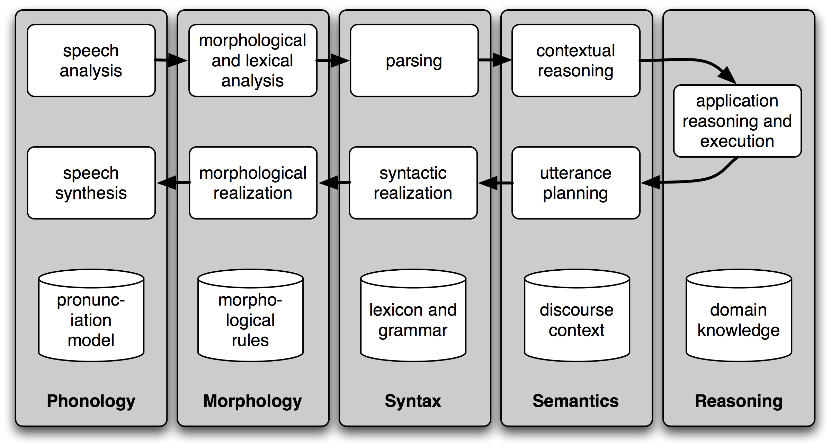
Sub-tasks

Slide 29
Sub-tasks
Phonology: speech analysis and synthesis
Morphology: Normalization, Stemming, Tokenization
Syntax: Part-of-speech tagging, Parsing
Semantics: (advanced) similarity, ontologies, dialog analysis
Reasoning: domain and application knowledge

Slide 30
Morphology
Morphemes:
The small meaningful units that make up words
Sub-steps:
Word normalization, case folding
Word tokenization
Word lemmatization
Stemming
Sentence Segmentation

Slide 31
Normalization
Need to “normalize” terms
Information Retrieval: indexed text & query terms must have same form.
We want to match U.S.A. and USA
We implicitly define equivalence classes of terms
e.g., deleting periods in a term
Alternative: asymmetric expansion:
Enter: window Search: window, windows
Enter: windows Search: Windows, windows, window
Enter: Windows Search: Windows
Potentially more powerful, but less efficient

Slide 32
Case folding
Applications like IR: reduce all letters to lower case
Since users tend to use lower case
Possible exception: upper case in mid-sentence?
e.g., General Motors
Fed vs. fed
SAIL vs. sail
For sentiment analysis, machine translation, Information extraction
Case is helpful (US versus us is important)

Slide 33
Morphology
Morphemes:
The small meaningful units that make up words
Stems: The core meaning-bearing units
Affixes: Bits and pieces that adhere to stems
Often with grammatical functions

Slide 34
Stemming
Reduce terms to their stems in information retrieval
Stemming is crude chopping of affixes
language dependent
e.g., automate(s), automatic, automation all reduced to automat.
for example compressed
and compression are both
accepted as equivalent to
compress.
for exampl compress and
compress ar both accept
as equival to compress

Slide 35
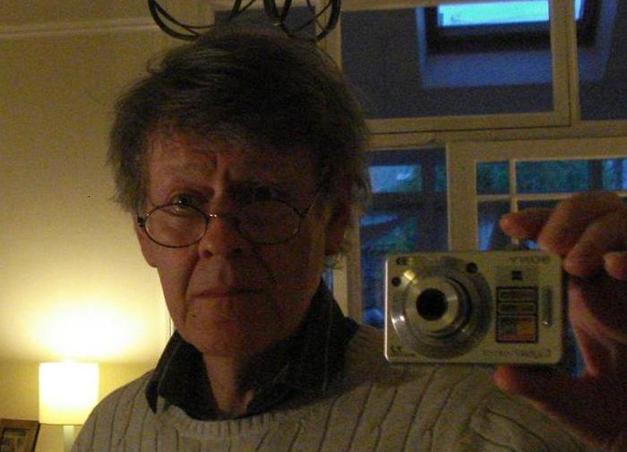
Porter stemmer
M.F. Porter, 1980, An algorithm for suffix stripping, Program,14(3) pp 130−137.
Good to use for indexing and want to support search using alternative forms of words
Simple cascade rules
Lexicon-free FST stemmer
FST – finite-state transducer
Type of finite automaton which maps between two sets of symbols
Can figure out exceptions e.g., Lying -> Lie
Rules, common errors:
https://tartarus.org/martin/PorterStemmer/

Slide 36
Porter’s algorithm The most common English stemmer
Step 1a
sses → ss caresses → caress
ies → i ponies → poni
ss → ss caress → caress
s → ø cats → cat
Step 1b
(*v*)ing → ø walking → walk
sing → sing
(*v*)ed → ø plastered → plaster
…
Step 2 (for long stems)
ational→ ate relational→ relate
izer→ ize digitizer → digitize
ator→ ate operator → operate
…
Step 3 (for longer stems)
al → ø revival → reviv
able → ø adjustable → adjust
ate → ø activate → activ
…
Notes:
only one rule is applied,
the one with the longest matching suffix S1 for the given word. This is true whether the rule succeeds or fails

Slide 37
Errors in Porter
doing something you should not have done
NOT doing something you should have done
Errors of commission |  | Errors of omission
organization | organ | european | (europe)
doing | doe | analysis | (analyzes)
numerical | numerous | noise | (noisy)
policy | police | sparse | (sparsity)
Notes:
Comission - (doing something you should not have done)
Omission (not doing something you should have done)

Slide 38
Improvements
Porter2
Lancaster
Snowball
A language for stemming algorithms
http://www.nltk.org/howto/stem.html

Slide 39
Lancaster stemmer
Significantly more aggressive than the porter stemmer
Faster
Short words obfuscated
More “exact” matching

Slide 40
Lemmatization
Reduce inflections or variant forms to base form
am, are, is → be
car, cars, car's, cars' → car
the boy's cars are different colors → the boy car be different color
Lemmatization: have to find correct dictionary headword form
Machine translation
Spanish quiero (‘I want’), quieres (‘you want’) same lemma as querer ‘want’

Slide 41
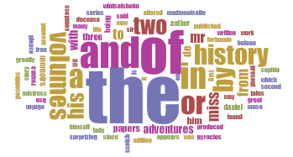
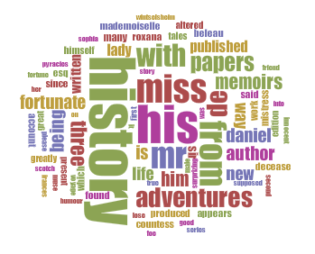
Stopwords
Stop list – high frequency words that may not contain much information
E.g., `it’, `and’, `a’, `the’…
Fiction titles published between 1660 and 1799
https://dlsatbsu.wordpress.com/
the, of, and, in, or, his, two, from, history, miss,
a, by, his, history, volumes papers, adventures, mr, with, de, s

Slide 42
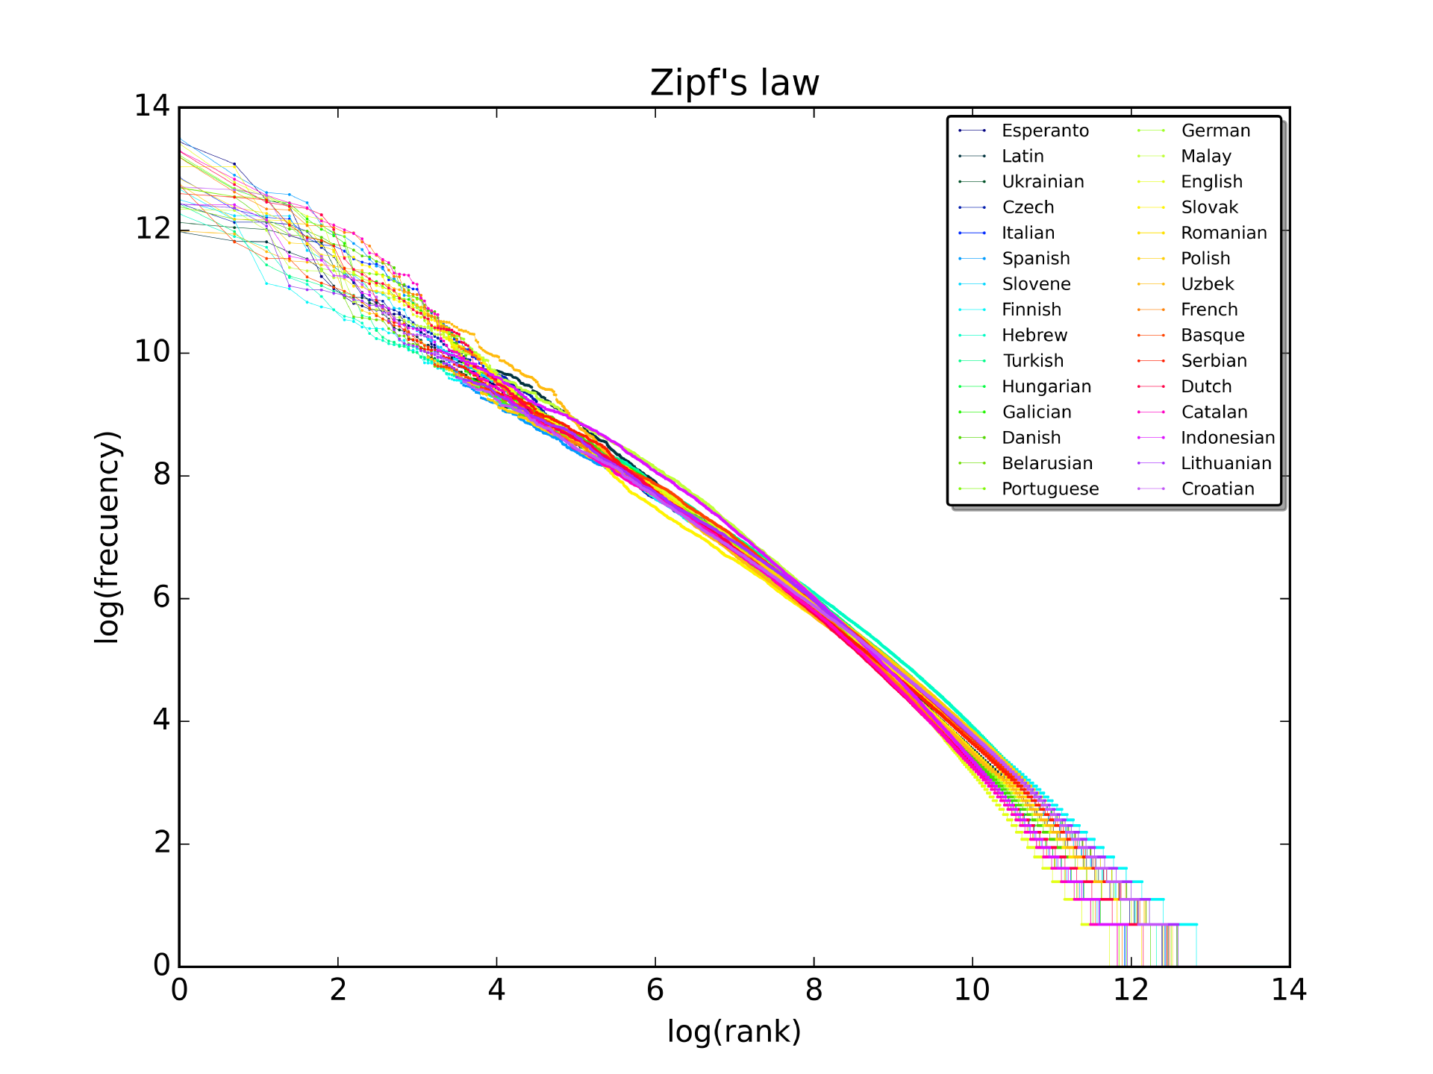
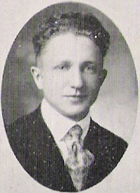
(George Kingslev) Zipf’s law
The frequency of any word is inversely proportional to its rank in the frequency table.
“Popular words are mentioned a lot more than unpopular words”.
Holds for most languages.
Rank | Word | Frequency
5 | a | 10144200
2201 | abandon | 15323
783 | ability | 51476
Notes:
Corpus of Contemporary American English. Top 5000 out of 450 million words. In alphabetic order

Slide 43

Tokenization
“`When I’M a Duchess, she said to herself,’ (not in a very hopeful tone though), ‘I won’t have any pepper in the my kitchen AT ALL. Soup does very well without—Maybe it’s always pepper that makes people hot-tempered,’…”
“`When I’M a Duchess, she said to herself,’ (not in a very hopeful tone though), ‘I won’t have any pepper in the my kitchen AT ALL. Soup does very well without—Maybe it’s always pepper that makes people hot-tempered,’…”
Split on non-word character?
Space beginning and end
How about punctuation? E.g., “(.,”
How about numbers?
dark horse
get cold feet
lose face
throw in the towel

Slide 44
Questions so far?

Slide 45
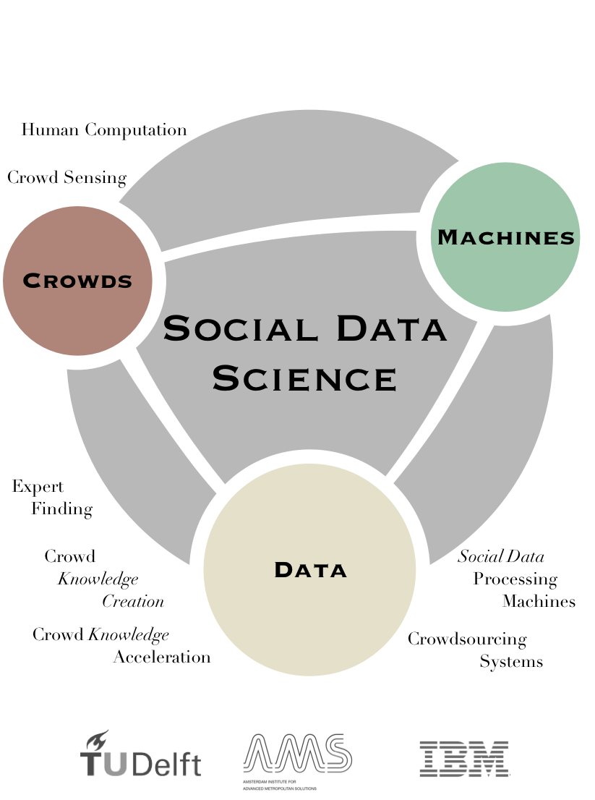
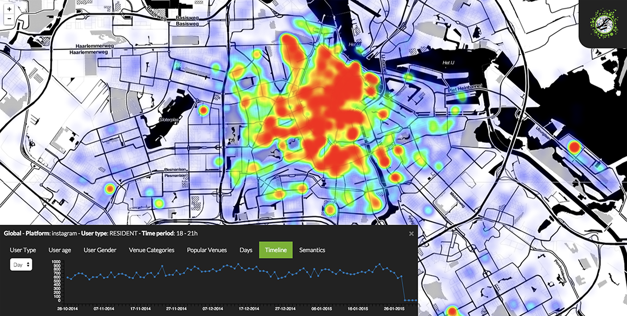


If you liked this course you’ll also like…
CS4145 - Crowd Computing
How large groups of people can solve complex tasks that are currently beyond the capabilities of AI, and that cannot be solved by a single person alone.
Gamification, conversational systems, human computation, and much much more...

Slide 46

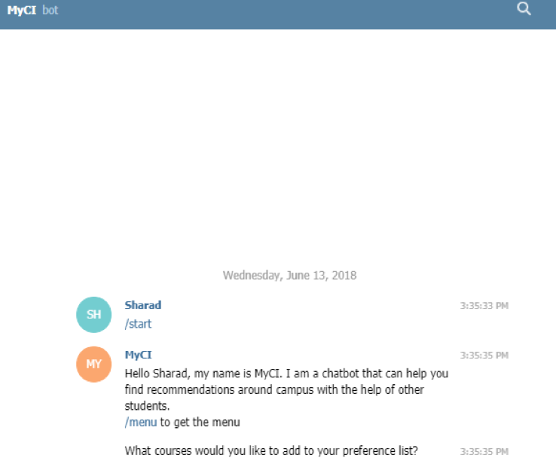
HUMAN AIDED CHATBOT FOR CAMPUS INFORMATION RETRIEVAL
Background: A new emerging hybrid chatbot system has spawned using human-based computation to improve response flexibility and request comprehension of chatbots.
In this project, we will test our human aided chatbot based on telegram. Students will use this chatbot to request or provide campus information. Through this project, we will find an effective user interface to improve the quality of results provided by workers. We’ll also compare the effectiveness and efficiency of traditional chatbot, hybrid chatbot and webpage-based crowdsourcing platform, by conducting several experiments among students.

Slide 47
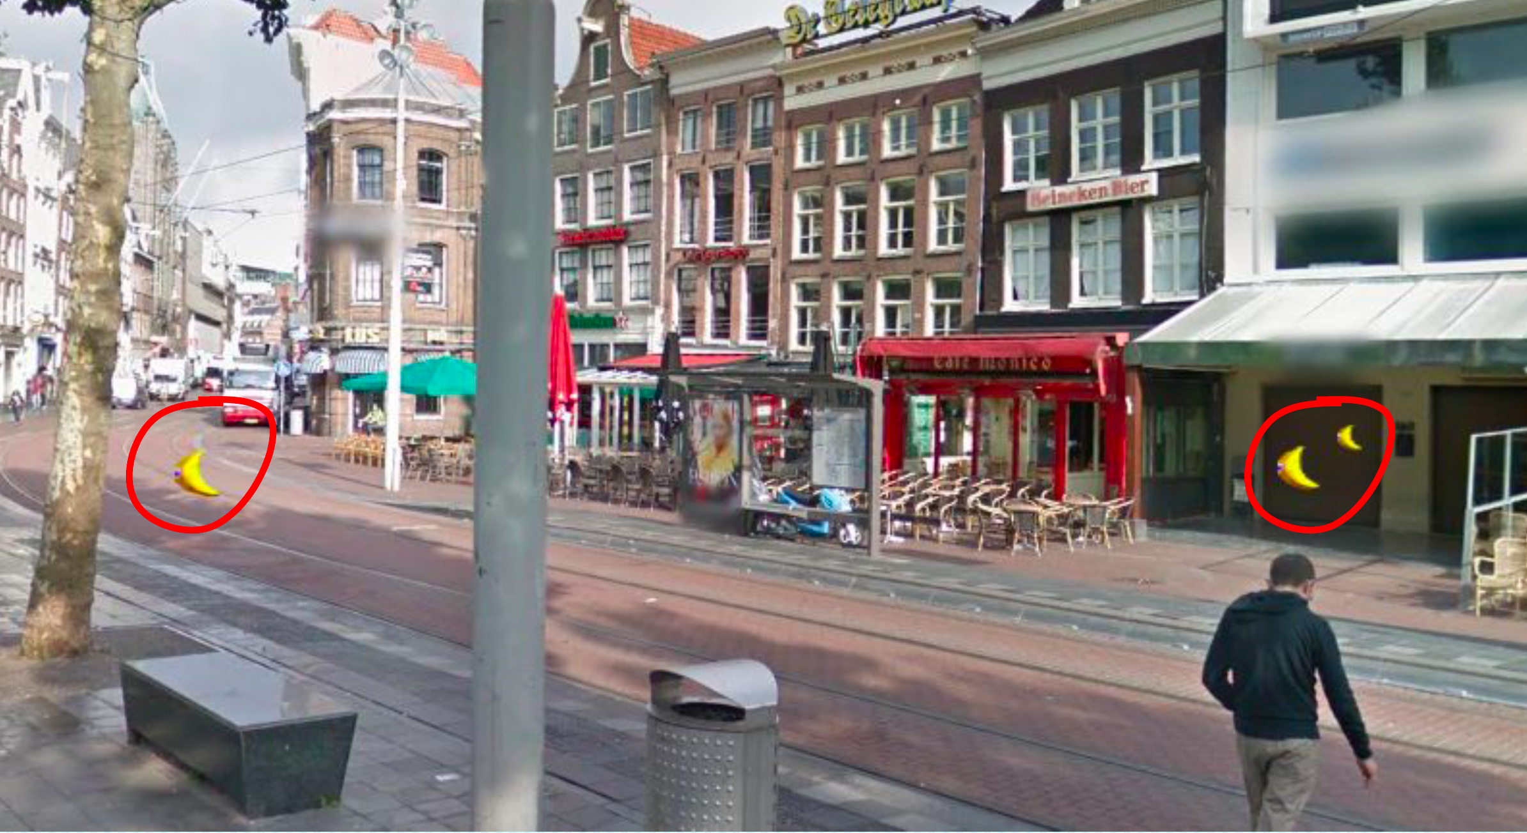
Trasherhunt
Background: Crowdsensing based on street view means the way to collect data by a group of people using web-based street panorama viewer.
In this project, we will test our crowdsensing platforms based on street panorama viewers (panorama data comes from Google and Amsterdam Data Science). Students are supposed to use this platform to find dirty/clean spots and trash bins in Noord-Zuid Lijn area (in Amsterdam). We will then compare the trash bin information collected by our platforms (Google and ADS) with OpenStreetMap (and ADS map). We’ll also analyse the relationship between “cleanness/dirtiness” and the density of trash bins.

Slide 48
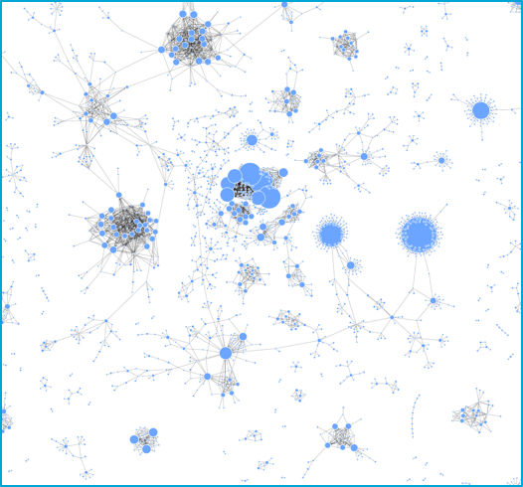
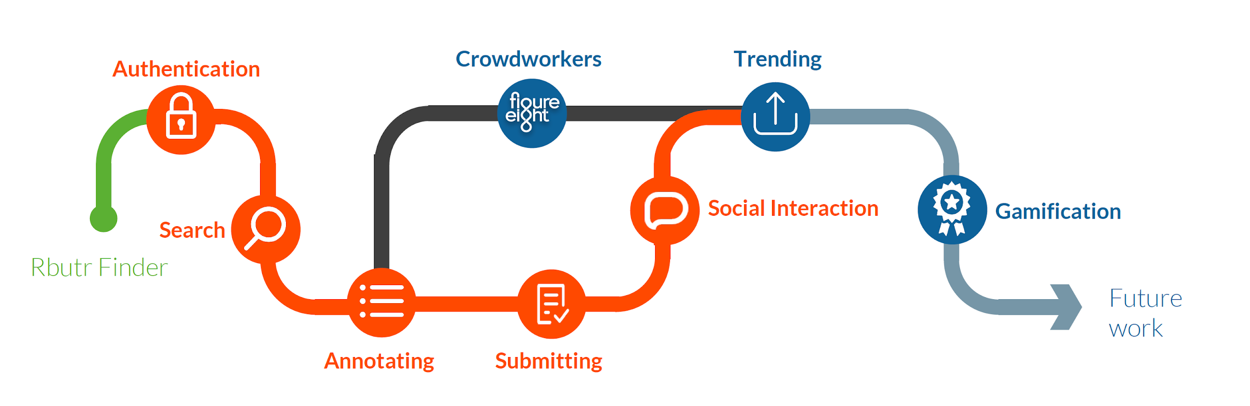
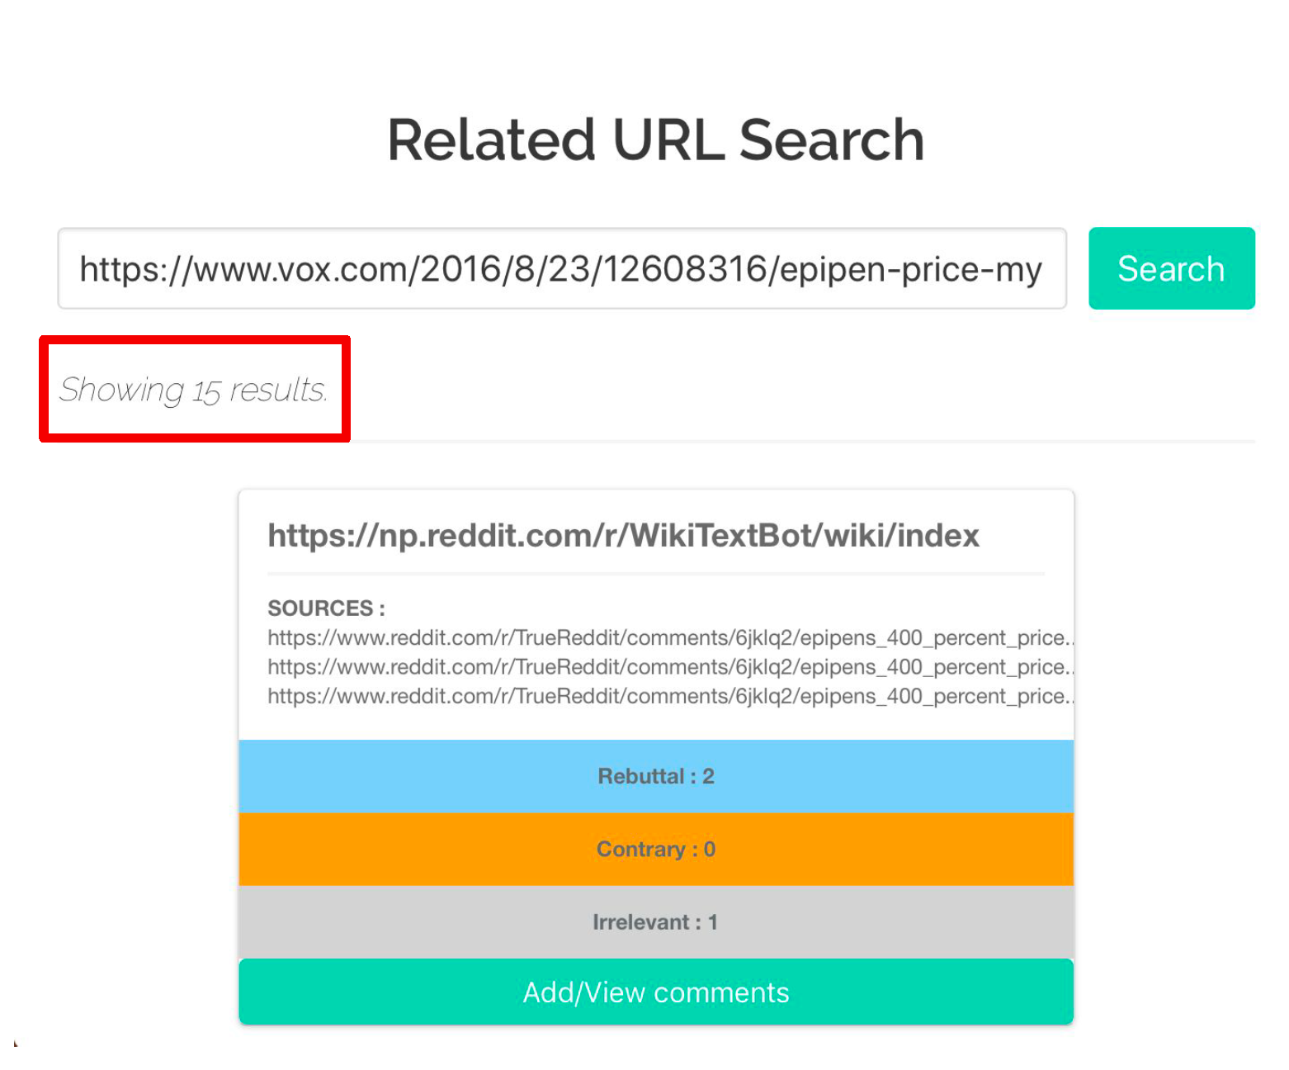
RBUTR
Created 2012
2K active users per week
60K total users
28K edges, 40K nodes
Encourage users to annotate relationship between nodes:
E.g., rebuttal, disagree, irrelevant
Use this information for an information seeking task.

Slide 49
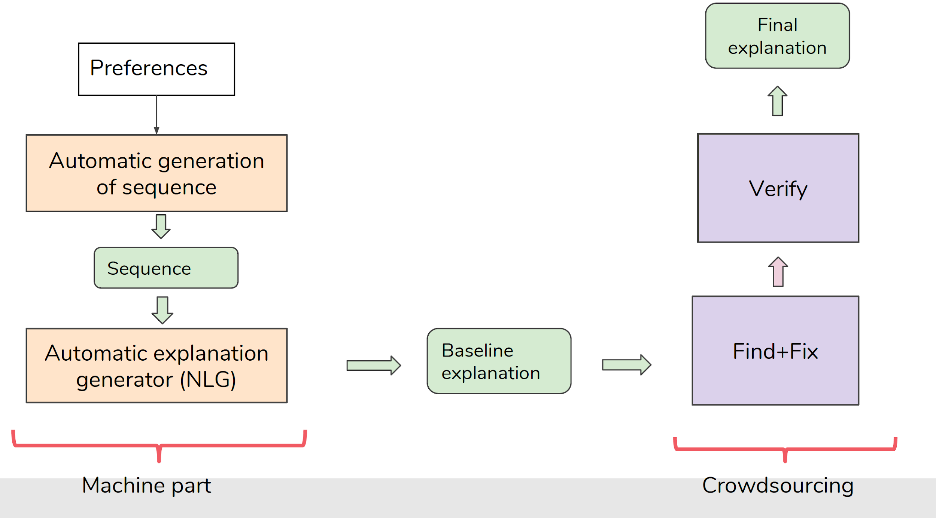
EXPLAINING SEQUENCES OF RECOMMENDATIONS
Use human computation to generate and evaluate explanations.

Slide 50
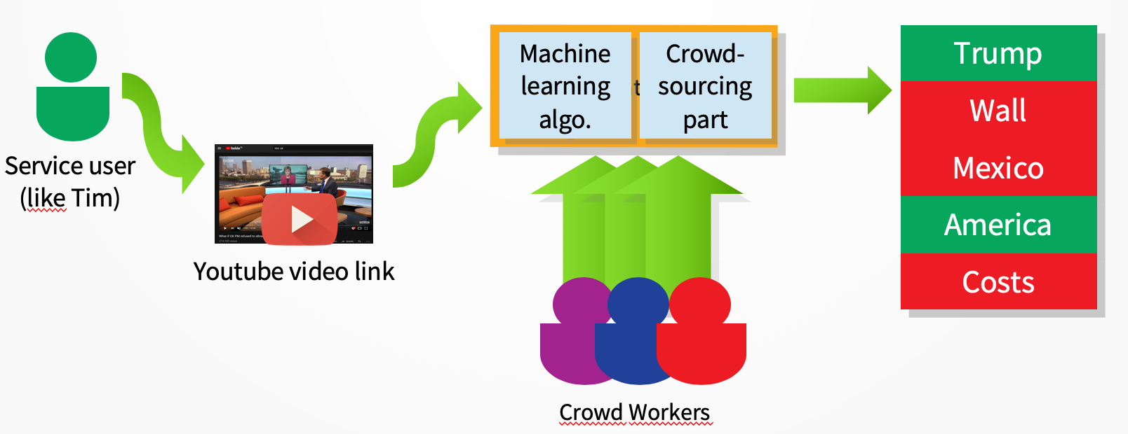
CAPTURING BIAS IN VISUAL NEWS SOURCES
Background: Using experts to harness ground truth can be tedious, time consuming and expensive. That is why with the help of crowdsourcing platforms and computer interfaces we could train a crowd for task that we would normally need several experts for. Additionally we could assist experts with their job.
In this project we want to help humanities and social science experts to codify videos with the help of the crowd. To be able to help the experts we will need to be able to cut the videos into smaller chunks and assign them to the Crowd. A useful library and tool to cut a complex task into simpler ones could be CrowdForge from Google Research. We will experiment with a specific example on coding bias with the use of an expert example and will scale it up with the use of the crowd in Figure8 platform.

Slide 51
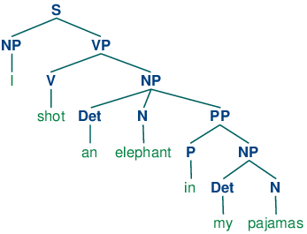

Syntax

Slide 52
Ambiguity makes NLP hard: “Crash blossoms”
Violinist Linked to JAL Crash Blossoms
Teacher Strikes Idle Kids
Red Tape Holds Up New Bridges
Hospitals Are Sued by 7 Foot Doctors
Juvenile Court to Try Shooting Defendant
Local High School Dropouts Cut in Half

Slide 53
Ambiguity is pervasive
New York Times headline (17 May 2000)
Fed raises interest rates
Fed raises interest rates
Fed raises interest rates 0.5%

Slide 54
Sentence Segmentation
!, ? are relatively unambiguous
Period “.” is quite ambiguous
Sentence boundary
Abbreviations like Inc. or Dr.
Numbers like .02% or 4.3
Build a binary classifier
Looks at a “.”
Decides EndOfSentence/NotEndOfSentence
Classifiers: hand-written rules, regular expressions, or machine-learning
NLTK uses Punkt (Kiss & Strunk, 2006)

Slide 55
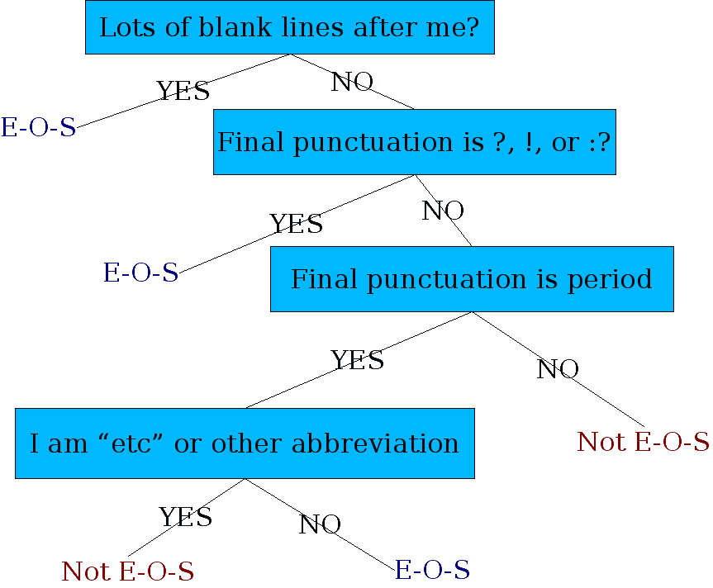
Determining if a word is end-of-sentence: a Decision Tree

Slide 56
More sophisticated decision tree features
Case of word with “.”: Upper, Lower, Cap, Number
Case of word after “.”: Upper, Lower, Cap, Number
Numeric features
Length of word with “.”
Probability (word with “.” occurs at end-of-s)
Probability (word after “.” occurs at beginning-of-s)

Slide 57
Implementing Decision Trees
A decision tree is just an if-then-else statement
The interesting research is choosing the features
Setting up the structure is often too hard to do by hand
Hand-building only possible for very simple features, domains
For numeric features, it’s too hard to pick each threshold
Instead, structure usually learned by machine learning from a training corpus

Slide 58
Decision Trees and other classifiers
We can think of the questions in a decision tree
As features that could be exploited by any kind of classifier
Naive Bayes
Logistic regression
SVM
Neural Nets
etc.

Slide 59
Models and algorithms
Models
State machines (e.g., automata)
Rule systems (i.e., grammars),
Logic (e.g., first order logic/predicate calculus),
Probabilistic models (e.g., hidden Markov models)
Vector-space models (i.e., linear algebra)
Algorithms
State space search (for e.g., speech recognition, syntactic parse, translation hypothesis)
Machine learning (e.g. Classifiers, Expectation-Maximization, and sequence models)

Slide 60
Next week...
Syntax (cont.)
Part-of-speech (POS) tagging
MM POS tagging: N-grams
Sentiment analysis
Named-entity recognition

Slide 61
After today you should be able to…
Explain the function of Natural Language Processing
Identify NLP applications
Identify typical natural processing tasks
Recognize typical components/sub-tasks
Next deadlines:
(No reading today)
Review P8: handed out March 15, due March 22.
NLP project proposal: due March 22.

Slide 62
Questions?
Room: 4.900 VMB 6 (Van Mourik Broekmanweg)
Office hours: Wednesdays 9-1pm (by appointment)
Email: ewi-4325@tudelft.nl
Or slack: in4325-ewi2019@tudelft.nl
Credits: Many of these slides are modified from the Stanford NLP course: https://web.stanford.edu/~jurafsky/NLPCourseraSlides.html

